Slide 1
Quantum Communication and It’s Implications for Secure Communication
Submitted in the partial fulfillment for the award of the degree of
BACHELOR OF ENGINEERING
IN
NAME_OF_SPECIALIZED_BRANCH
Submitted by:
Harsh Anurag (20CBS1010)
Lovish Thakral (20CBS1021)
Agam Pratap Singh(20CBS1024)
Under the Supervision of:
Ms. Upasana Tiwari
Department of AIT-CSE
DISCOVER . LEARN . EMPOWER

Slide 2
Outline
Introduction to Project
Problem Formulation
Objectives of the work
Methodology used
Results and Outputs
Conclusion
Future Scope
References

Slide 3
Introduction to Project
Quantum Communication: Harnessing the Power of Quantum Mechanics for Secure Communication.
Traditional communication methods face challenges in ensuring absolute security due to vulnerabilities in encryption.
Quantum communication utilizes principles of quantum mechanics to achieve unprecedented levels of security and privacy.

Slide 4
Introduction to Project
Quantum communication relies on the fundamental principles of quantum mechanics, such as superposition and entanglement.
Quantum bits or qubits represent information in a state of superposition, allowing for the transmission of information in multiple states simultaneously.
Quantum key distribution (QKD) enables the exchange of encryption keys encoded in quantum states, ensuring that any attempt to intercept the key alters its state, thus alerting the communicating parties to the breach.

Slide 5
Introduction to Project
Quantum communication offers unbreakable encryption, providing a secure means of transmitting sensitive data.
Applications extend to fields such as finance, government, and healthcare, where data privacy is paramount.
Quantum communication paves the way for a future where secure communication is not just a possibility but a reality, safeguarding information in an increasingly digital world.

Slide 6
Problem Formulation
Current encryption methods face challenges from advancements in computing power and the emergence of quantum computing.
Traditional encryption can be vulnerable to attacks, including brute-force and quantum-based attacks, compromising data security.
The need for a more robust encryption solution that can withstand evolving threats and ensure the privacy of sensitive information is critical.

Slide 7
Problem Formulation
Quantum communication offers a solution to the vulnerabilities of traditional encryption methods by leveraging the principles of quantum mechanics.
By harnessing properties like superposition and entanglement, quantum communication enables the transmission of data with unparalleled security.
Implementing quantum communication technologies such as quantum key distribution (QKD) provides a pathway to address the growing need for secure communication in an era of advancing cyber threats.

Slide 8
Objectives of the Work
Develop and implement quantum communication protocols, particularly Quantum Key Distribution (QKD), to establish ultra-secure channels for transmitting sensitive data.
Explore the practical applications of quantum communication technologies in diverse fields, including finance, government, and healthcare, to address the pressing need for robust data security.
Contribute to the advancement of quantum communication research, aiming to establish a foundation for secure communication in the face of evolving cybersecurity threats.

Slide 9
Methodology used
Phase 1: Theoretical Framework
Conduct an in-depth review of quantum communication principles and protocols.
Explore existing research to understand the theoretical underpinnings of quantum key distribution (QKD) and other quantum communication techniques.
Phase 2: Experimental Setup
Design and implement experimental setups to test and validate quantum communication protocols.
Utilize quantum devices and technologies to simulate real-world communication scenarios.

Slide 10
Methodology used
Phase 3: Data Collection and Analysis
Perform experiments to gather data on the performance and effectiveness of quantum communication protocols.
Analyze collected data to assess the security and reliability of quantum communication channels.
Phase 4: Optimization and Refinement
Iterate on experimental setups and protocols based on data analysis findings.
Optimize quantum communication techniques to enhance security, efficiency, and scalability.
Phase 5: Documentation and Dissemination
Document methodologies, findings, and insights for publication in scientific journals and conference proceedings.
Share results with the scientific community to contribute to the advancement of quantum communication research.

Slide 11
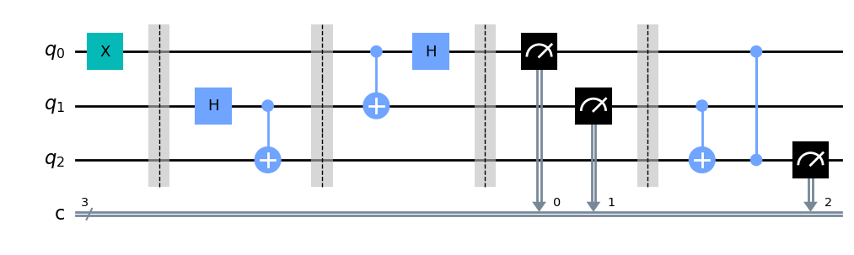
Results and Outputs
Output 1 :

Slide 12
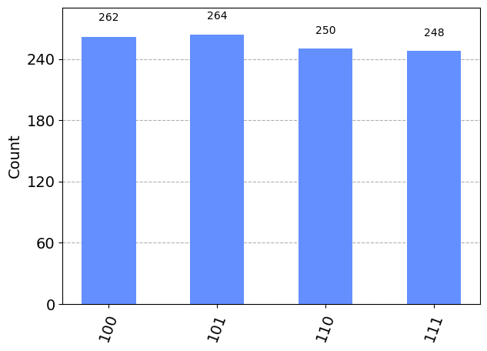
Results and Outputs
Output 2 :

Slide 13
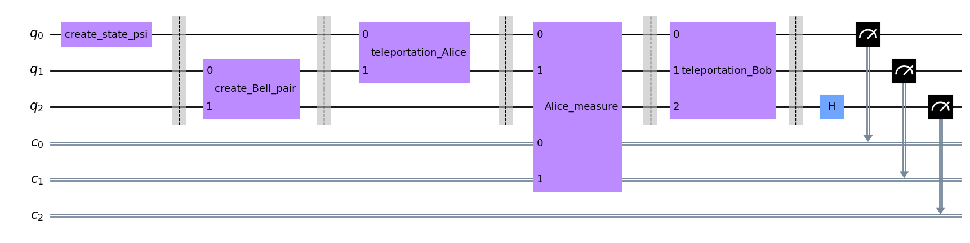
Results and Outputs
Output 3 :

Slide 14
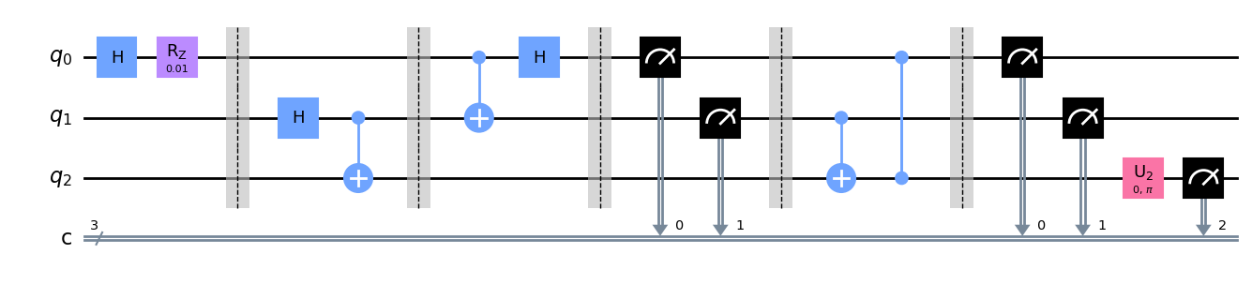
Results and Outputs
Output 4 :

Slide 15
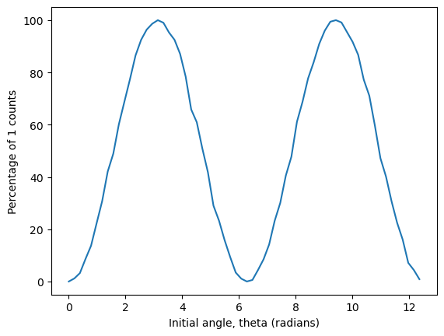
Results and Outputs
Output 5 :

Slide 16
Future Scope
Further Research and Development
Explore advancements in quantum communication technologies, including quantum repeaters and quantum networks, to enhance scalability and range.
Investigate novel quantum encryption schemes and protocols to address emerging cybersecurity challenges and ensure long-term data security.
Practical Applications
Extend the implementation of quantum communication technologies to critical infrastructure sectors such as banking, telecommunications, and defense, to bolster cybersecurity measures.
Foster collaborations between academia, industry, and government agencies to accelerate the adoption of quantum communication solutions for secure communication worldwide.

Slide 17
Conclusion
Quantum communication represents a paradigm shift in secure communication, offering unprecedented levels of security and privacy through the principles of quantum mechanics.
Through rigorous research, experimentation, and innovation, this project has contributed to advancing the field of quantum communication and laying the groundwork for future secure communication technologies.
As we continue to explore the potential of quantum communication, collaboration and investment in research and development will be essential to realize its full potential and ensure a secure digital future.

Slide 18
References
Bennett, C. H., & Brassard, G. (1984). Quantum cryptography: Public key distribution and coin tossing. In Proceedings of IEEE International Conference on Computers, Systems and Signal Processing (Vol. 175, No. 8, pp. 175-179).
Gisin, N., Ribordy, G., Tittel, W., & Zbinden, H. (2002). Quantum cryptography. Reviews of Modern Physics, 74(1), 145.
Scarani, V., Bechmann-Pasquinucci, H., Cerf, N. J., Dušek, M., Lütkenhaus, N., & Peev, M. (2009). The security of practical quantum key distribution. Reviews of Modern Physics, 81(3), 1301.

Slide 19
References
Lo, H. K., Curty, M., & Qi, B. (2014). Measurement-device-independent quantum key distribution. Physical Review Letters, 108(13), 130503.
Pirandola, S., Braunstein, S. L., & Lloyd, S. (2019). Quantum internet: A vision for the road ahead. European Physical Journal D, 72(10), 169.
Yin, J., Cao, Y., Li, Y. H., Liao, S. K., Zhang, L., Ren, J. G., ... & Zhang, Q. (2020). Satellite-to-ground quantum key distribution. Nature, 582(7813), 501-505.

